Slide 1
Abstract algebra Ch 30 Cayley digraphs of groups

Slide 2
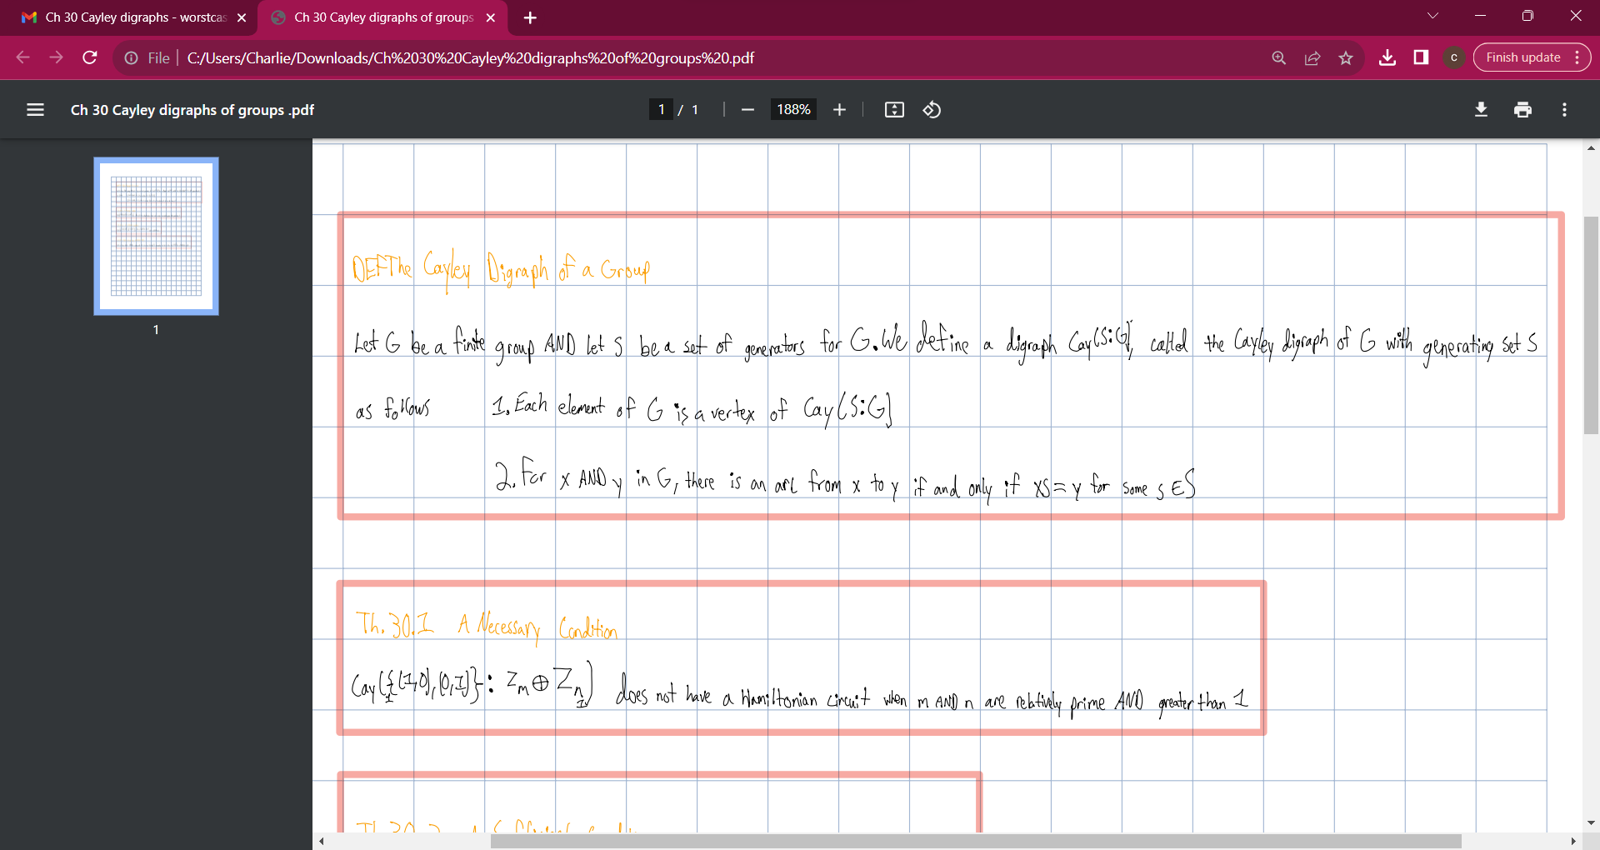

Slide 3
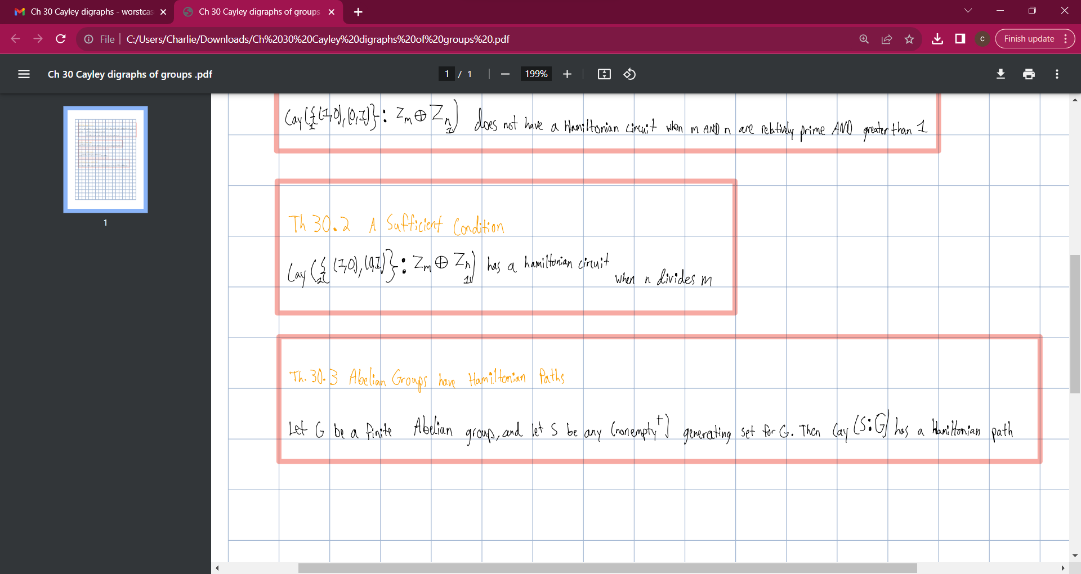

Slide 4


